Slide 1
Unit 4
Software Testing Strategies
A strategic approach to testing
Test strategies for conventional software
Test strategies for object-oriented software
Validation testing
System testing
The art of debugging
(Source: Pressman, R. Software Engineering: A Practitioner’s Approach. McGraw-Hill, 2005)

Slide 2
Introduction
A strategy for software testing integrates the design of software test cases into a well-planned series of steps that result in successful development of the software
The strategy provides a road map that describes the steps to be taken, when, and how much effort, time, and resources will be required
The strategy incorporates test planning, test case design, test execution, and test result collection and evaluation
The strategy provides guidance for the practitioner and a set of milestones for the manager
Because of time pressures, progress must be measurable and problems must surface as early as possible

Slide 3
What is Testing?
Software Testing is a method to check whether the actual software product matches expected requirements and to ensure that software product is Defect free.
It involves execution of software/system components using manual or automated tools to evaluate one or more properties of interest.
The purpose of software testing is to identify errors, gaps or missing requirements in contrast to actual requirements.

Slide 4




Why do we need to Test?
Cost Effective – Testing our project on time can save money in the long run. Software development consists of many stages and if bugs are caught in the earlier stages it costs much less to fix them.
Security- Users are always looking for trusted products that they can rely on. It helps in removing problems and risks beforehand.
Product Quality - It is important to follow the product requirements
because it helps you get the required end results.
Customer Satisfaction – The ultimate goal for a product owner is to
give the best customer satisfaction. Software should be tested in order
to bring the best user experience possible. Being the best product in this
saturated market will help you gain trustworthy clients which will have
great long-term effects.

Slide 5
Testing Vs Debugging
Testing | Debugging
Performed by testers | Performed by developer or development team
Can be done manually or automatically | Can only be done manually
Can be predefined when starting testing. The test result could be predicted | Start with unknown conditions and it is hard to predict the result
Find the programming failure | Demonstrate that it’s only an unattended small mistake
Could be done automatically by using automated testing tools | Automatic debugging of software is still a dream of programmers
The purpose is to find the bug | The purpose is to find the cause of a bug

Slide 6
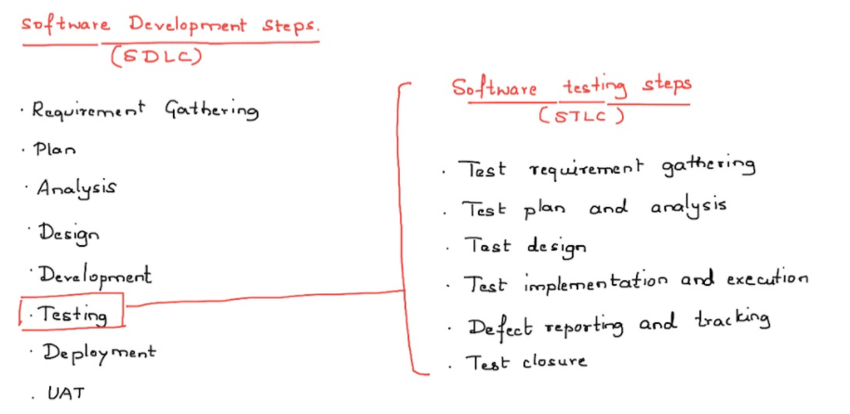
Process of Testing

Slide 7
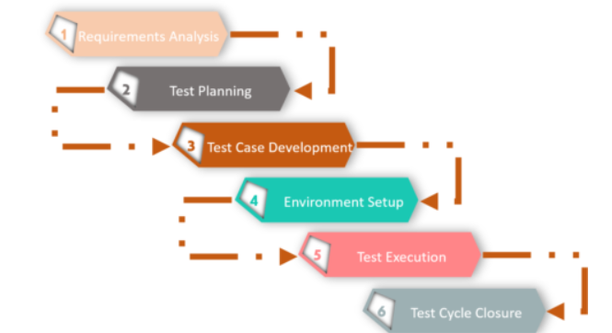
Testing Process

Slide 8
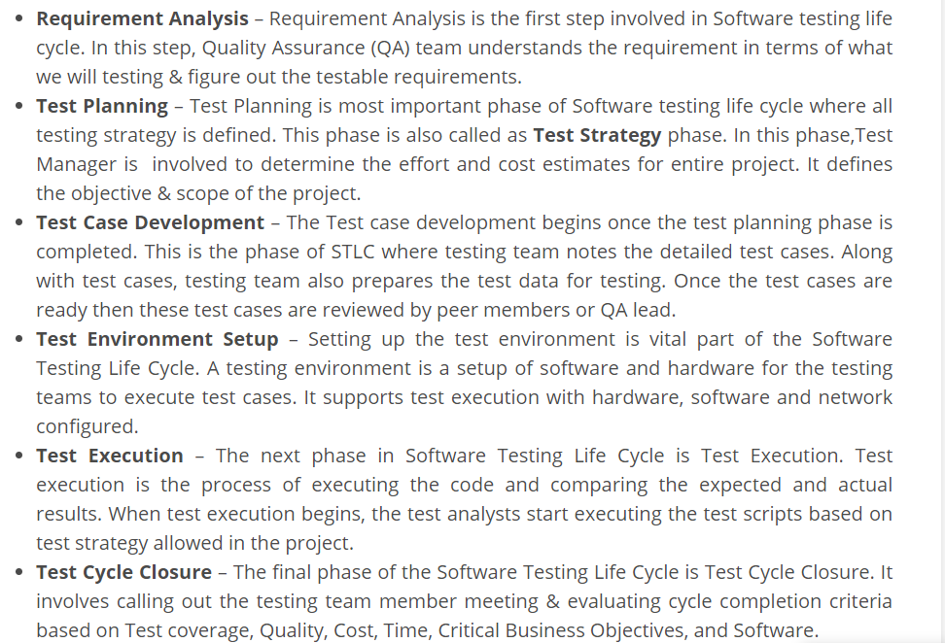

Slide 9
Types of Testing
The type of testing depends on various factors, including project requirements, budget, timeline, expertise, and suitability.
Manual Testing – Manual Testing is a type of Software Testing where Testers manually execute test cases without using any automation tools.
  Stryka
  Bugzilla
  Jira
  Mantis
  Trac
  Redmine
  Fogbuz
  Lighthouse

Slide 10
Automated Testing – Automation testing is an Automatic technique where the tester writes scripts by own and uses suitable software to test the software. It is basically an automation process of a manual process.
Some of the tools used for Automated Testing are
  Selenium
  TestingWhiz
  Ranorex
  Sahi
  Waitir
  WaitiN
  Tosca TestSuite

Slide 11
Process of Debugging
Reproduce the problem.
Describe the bug. Try to get as much input from the user to get the exact reason.
Capture the program snapshot when the bug appears. Try to get all the variable values and states of the program at that time.
Analyse the snapshot based on the state and action. Based on that try to find the cause of the bug.
Fix the existing bug, but also check that any new bug does not occur.

Slide 12
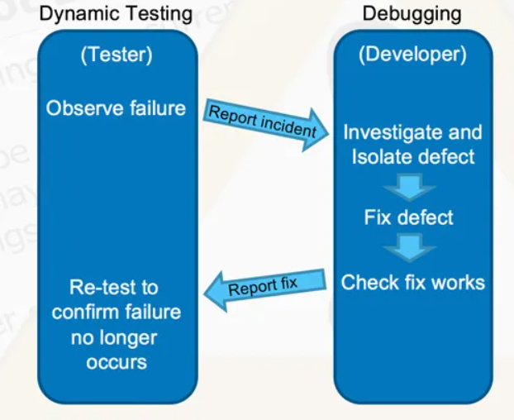

Slide 13
A Strategic Approach to Testing

Slide 14
General Characteristics of Strategic Testing
To perform effective testing, a software team should conduct effective formal technical reviews
Testing begins at the component level and work outward toward the integration of the entire computer-based system
Different testing techniques are appropriate at different points in time
Testing is conducted by the developer of the software and (for large projects) by an independent test group
Testing and debugging are different activities, but debugging must be accommodated in any testing strategy

Slide 15
Verification and Validation
Software testing is part of a broader group of activities called verification and validation that are involved in software quality assurance
Verification (Are the algorithms coded correctly?)
  The set of activities that ensure that software correctly implements a specific function or algorithm
Validation (Does it meet user requirements?)
  The set of activities that ensure that the software that has been built is traceable to customer requirements

Slide 16
Verification Vs Validation
S.No. | Verification | Validation
1. | Verification addresses the concern: "Are you building it right?" | Validation addresses the concern: "Are you building the right thing?"
2. | “A test of a system to prove that it meets all its specified requirements at a particular stage of its development.” | “An activity that ensures that an end product stakeholder’s true needs and expectations are met.”
3. | Ensures that the software system meets all the functionality. | Ensures that the functionalities meet the intended behavior.
4. | Verification takes place first and includes the checking for documentation, code, etc. | Validation occurs after verification and mainly involves the checking of the overall product.
5. | Done by developers. | Done by testers.
6. | It has static activities, as it includes collecting reviews, walkthroughs, and inspections to verify a software. | It has dynamic activities, as it includes executing the software against the requirements.
7. | It is an objective process and no subjective decision should be needed to verify a software. | It is a subjective process and involves subjective decisions on how well a software works.

Slide 17
Organizing for Software Testing
Testing should aim at "breaking" the software
Common misconceptions
  The developer of software should do no testing at all
  The software should be given to a secret team of testers who will test it unmercifully
  The testers get involved with the project only when the testing steps are about to begin
Reality: Independent test group
  Removes the inherent problems associated with letting the builder test the software that has been built
  Removes the conflict of interest that may otherwise be present
  Works closely with the software developer during analysis and design to ensure that thorough testing occurs

Slide 18
A Strategy for Testing Conventional Software
System Testing
Narrow to
Broader scope
Validation Testing
Integration Testing
Unit Testing
Code
Abstract to
concrete
Design
Requirements
System Engineering

Slide 19
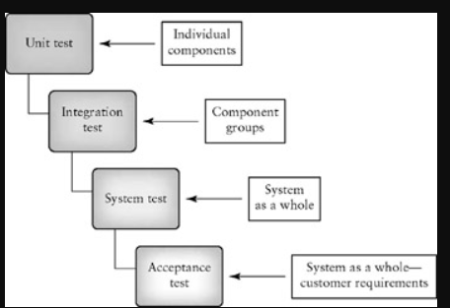
Levels of Testing

Slide 20
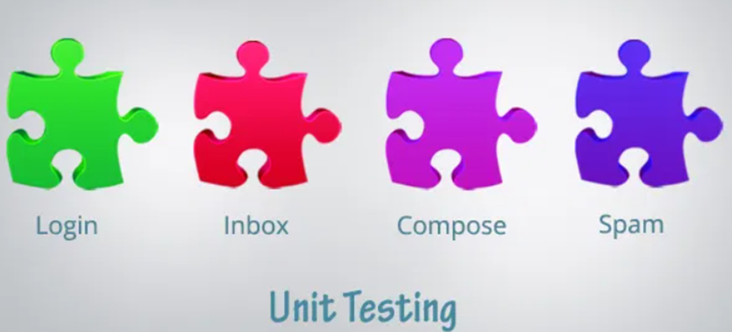
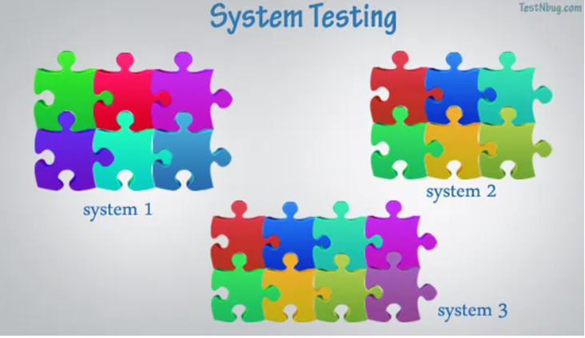
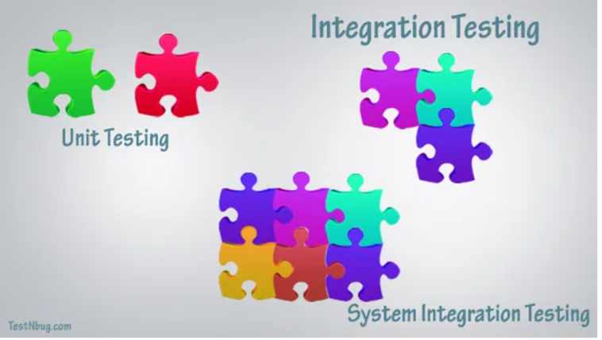

Slide 21
Unit Testing
A unit is a module or a small set of modules.
Unit testing is a method by which individual units of source code are tested to determine if they are ready for use.
Unit testing is performed by Programmer:
  Although, a tester can help.
  He Requires detailed knowledge of the internal program design and code.
The units are tested in isolation which ensures the component is working according to the detailed design/build specifications of the module.

Slide 22
Integration Testing
A System is made up of different components or modules (individual units)
Testing the interactions between such modules is called as integration testing.
Integration Testing starts with testing the interactions between few modules and ends when all the interfaces of different systems are integrated.

Slide 23
System Testing
System testing of software is defined as the “investigation conducted to evaluate whether a complete and integrated software system meets the requirements given by the client”
System testing is all about validating and verifying the functional design specifications and seeing how all the modules work together.

Slide 24
Validation Testing
The process of evaluating software during the development process or at the end of the development process to determine whether it satisfies specified business requirements.
Validation Testing ensures that the product actually meets the client's needs. It can also be defined as to demonstrate that the product fulfills its intended use when deployed on appropriate environment.
Validation testing can be best demonstrated using V-Model. The Software/product under test is evaluated during this type of testing.
This is also known as ‘Beta Testing’, ‘Application Testing’, and ‘End user Testing’.

Slide 25
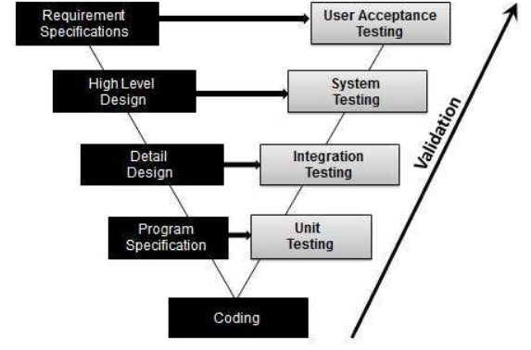

Slide 26
Testing Strategy applied to Conventional Software
Unit testing
  Exercises specific paths in a component's control structure to ensure complete coverage and maximum error detection
  Components are then assembled and integrated
Integration testing
  Focuses on inputs and outputs, and how well the components fit together and work together
Validation testing
  Provides final assurance that the software meets all functional, behavioral, and performance requirements
System testing
  Verifies that all system elements (software, hardware, people, databases) mesh properly and that overall system function and performance is achieved

Slide 27
When is Testing Complete?
There is no definitive answer to this question
Every time a user executes the software, the program is being tested
Sadly, testing usually stops when a project is running out of time, money, or both
One approach is to divide the test results into various severity levels
  Then consider testing to be complete when certain levels of errors no longer occur or have been repaired or eliminated

Slide 28
Ensuring a Successful Software Test Strategy
Specify product requirements in a quantifiable manner long before testing commences
State testing objectives explicitly in measurable terms
Understand the user of the software (through use cases) and develop a profile for each user category
Develop a testing plan that emphasizes rapid cycle testing to get quick feedback to control quality levels and adjust the test strategy
Build robust software that is designed to test itself and can diagnose certain kinds of errors
Use effective formal technical reviews as a filter prior to testing to reduce the amount of testing required
Conduct formal technical reviews to assess the test strategy and test cases themselves
Develop a continuous improvement approach for the testing process through the gathering of metrics

Slide 29
Test Strategies for
Conventional Software

Slide 30
Unit Testing
Focuses testing on the function or software module
Concentrates on the internal processing logic and data structures
Is simplified when a module is designed with high cohesion
  Reduces the number of test cases
  Allows errors to be more easily predicted and uncovered
Concentrates on critical modules and those with high cyclomatic complexity when testing resources are limited

Slide 31
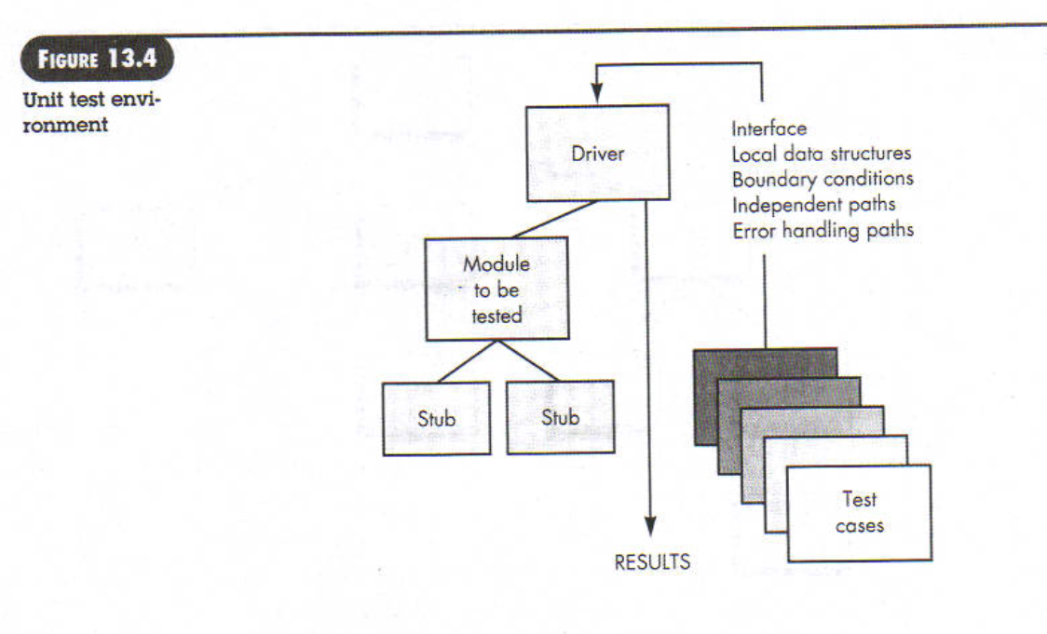

Slide 32
Drivers and Stubs for
Unit Testing
Driver
  A simple main program that accepts test case data, passes such data to the component being tested, and prints the returned results
Stubs
  Serve to replace modules that are subordinate to (called by) the component to be tested
  It uses the module’s exact interface, may do minimal data manipulation, provides verification of entry, and returns control to the module undergoing testing
Drivers and stubs both represent overhead
  Both must be written but don’t constitute part of the installed software product

Slide 33
Targets for Unit Test Cases
Module interface
  Ensure that information flows properly into and out of the module
Local data structures
  Ensure that data stored temporarily maintains its integrity during all steps in an algorithm execution
Boundary conditions
  Ensure that the module operates properly at boundary values established to limit or restrict processing
Independent paths (basis paths)
  Paths are exercised to ensure that all statements in a module have been executed at least once
Error handling paths
  Ensure that the algorithms respond correctly to specific error conditions

Slide 34
Common Computational Errors in Execution Paths
Misunderstood or incorrect arithmetic precedence
Mixed mode operations (e.g., int, float, char)
Incorrect initialization of values
Precision inaccuracy and round-off errors
Incorrect symbolic representation of an expression (int vs. float)

Slide 35
Other Errors to Uncover
Comparison of different data types
Incorrect logical operators or precedence
Expectation of equality when precision error makes equality unlikely (using == with float types)
Incorrect comparison of variables
Improper or nonexistent loop termination
Failure to exit when divergent iteration is encountered
Improperly modified loop variables
Boundary value violations

Slide 36
Problems to uncover in
Error Handling
Error description is unintelligible or ambiguous
Error noted does not correspond to error encountered
Error condition causes operating system intervention prior to error handling
Exception condition processing is incorrect
Error description does not provide enough information to assist in the location of the cause of the error

Slide 37
Integration Testing
Defined as a systematic technique for constructing the software architecture
  At the same time integration is occurring, conduct tests to uncover errors associated with interfaces
Objective is to take unit tested modules and build a program structure based on the prescribed design
Two Approaches
  Non-incremental Integration Testing
  Incremental Integration Testing

Slide 38
Non-incremental
Integration Testing
Commonly called the “Big Bang” approach
All components are combined in advance
The entire program is tested as a whole
Chaos results
Many seemingly-unrelated errors are encountered
Correction is difficult because isolation of causes is complicated
Once a set of errors are corrected, more errors occur, and testing appears to enter an endless loop

Slide 39
Incremental Integration Testing
Three kinds
  Top-down integration
  Bottom-up integration
  Sandwich integration
The program is constructed and tested in small increments
Errors are easier to isolate and correct
Interfaces are more likely to be tested completely
A systematic test approach is applied

Slide 40
Top-down Integration
Modules are integrated by moving downward through the control hierarchy, beginning with the main module
Subordinate modules are incorporated in either a depth-first or breadth-first fashion
  DF: All modules on a major control path are integrated
  BF: All modules directly subordinate at each level are integrated
Advantages
  This approach verifies major control or decision points early in the test process
Disadvantages
  Stubs need to be created to substitute for modules that have not been built or tested yet; this code is later discarded
  Because stubs are used to replace lower level modules, no significant data flow can occur until much later in the integration/testing process

Slide 41
Bottom-up Integration
Integration and testing starts with the most atomic modules in the control hierarchy
Advantages
  This approach verifies low-level data processing early in the testing process
  Need for stubs is eliminated
Disadvantages
  Driver modules need to be built to test the lower-level modules; this code is later discarded or expanded into a full-featured version
  Drivers inherently do not contain the complete algorithms that will eventually use the services of the lower-level modules; consequently, testing may be incomplete or more testing may be needed later when the upper level modules are available

Slide 42
Sandwich Integration
Consists of a combination of both top-down and bottom-up integration
Occurs both at the highest level modules and also at the lowest level modules
Proceeds using functional groups of modules, with each group completed before the next
  High and low-level modules are grouped based on the control and data processing they provide for a specific program feature
  Integration within the group progresses in alternating steps between the high and low level modules of the group
  When integration for a certain functional group is complete, integration and testing moves onto the next group
Reaps the advantages of both types of integration while minimizing the need for drivers and stubs
Requires a disciplined approach so that integration doesn’t tend towards the “big bang” scenario

Slide 43
Regression Testing
Each new addition or change to baselined software may cause problems with functions that previously worked flawlessly
Regression testing re-executes a small subset of tests that have already been conducted
  Ensures that changes have not propagated unintended side effects
  Helps to ensure that changes do not introduce unintended behavior or additional errors
  May be done manually or through the use of automated capture/playback tools
Regression test suite contains three different classes of test cases
  A representative sample of tests that will exercise all software functions
  Additional tests that focus on software functions that are likely to be affected by the change
  Tests that focus on the actual software components that have been changed

Slide 44
Smoke Testing
Taken from the world of hardware
  Power is applied and a technician checks for sparks, smoke, or other dramatic signs of fundamental failure
Designed as a pacing mechanism for time-critical projects
  Allows the software team to assess its project on a frequent basis
Includes the following activities
  The software is compiled and linked into a build
  A series of breadth tests is designed to expose errors that will keep the build from properly performing its function
    The goal is to uncover “show stopper” errors that have the highest likelihood of throwing the software project behind schedule
  The build is integrated with other builds and the entire product is smoke tested daily
    Daily testing gives managers and practitioners a realistic assessment of the progress of the integration testing
  After a smoke test is completed, detailed test scripts are executed

Slide 45
Benefits of Smoke Testing
Integration risk is minimized
  Daily testing uncovers incompatibilities and show-stoppers early in the testing process, thereby reducing schedule impact
The quality of the end-product is improved
  Smoke testing is likely to uncover both functional errors and architectural and component-level design errors
Error diagnosis and correction are simplified
  Smoke testing will probably uncover errors in the newest components that were integrated
Progress is easier to assess
  As integration testing progresses, more software has been integrated and more has been demonstrated to work
  Managers get a good indication that progress is being made

Slide 46
Test Strategies for
Object-Oriented Software

Slide 47
Test Strategies for
Object-Oriented Software
With object-oriented software, you can no longer test a single operation in isolation (conventional thinking)
Traditional top-down or bottom-up integration testing has little meaning
Class testing for object-oriented software is the equivalent of unit testing for conventional software
  Focuses on operations encapsulated by the class and the state behavior of the class
Drivers can be used
  To test operations at the lowest level and for testing whole groups of classes
  To replace the user interface so that tests of system functionality can be conducted prior to implementation of the actual interface
Stubs can be used
  In situations in which collaboration between classes is required but one or more of the collaborating classes has not yet been fully implemented

Slide 48
Testing Strategy applied to Object-Oriented Software
Must broaden testing to include detections of errors in analysis and design models
Unit testing loses some of its meaning and integration testing changes significantly
Use the same philosophy but different approach as in conventional software testing
Test "in the small" and then work out to testing "in the large"
  Testing in the small involves class attributes and operations; the main focus is on communication and collaboration within the class
  Testing in the large involves a series of regression tests to uncover errors due to communication and collaboration among classes
Finally, the system as a whole is tested to detect errors in fulfilling requirements

Slide 49
Test Strategies for Object-Oriented Software (continued)
Two different object-oriented testing strategies
  Thread-based testing
    Integrates the set of classes required to respond to one input or event for the system
    Each thread is integrated and tested individually
    Regression testing is applied to ensure that no side effects occur
  Use-based testing
    First tests the independent classes that use very few, if any, server classes
    Then the next layer of classes, called dependent classes, are integrated
    This sequence of testing layer of dependent classes continues until the entire system is constructed

Slide 50
Validation Testing

Slide 51
Background
Validation testing follows integration testing
The distinction between conventional and object-oriented software disappears
Focuses on user-visible actions and user-recognizable output from the system
Demonstrates conformity with requirements
Designed to ensure that
  All functional requirements are satisfied
  All behavioral characteristics are achieved
  All performance requirements are attained
  Documentation is correct
  Usability and other requirements are met (e.g., transportability, compatibility, error recovery, maintainability)
After each validation test
  The function or performance characteristic conforms to specification and is accepted
  A deviation from specification is uncovered and a deficiency list is created
A configuration review or audit ensures that all elements of the software configuration have been properly developed, cataloged, and have the necessary detail for entering the support phase of the software life cycle

Slide 52
Alpha and Beta Testing
Alpha testing
  Conducted at the developer’s site by end users
  Software is used in a natural setting with developers watching intently
  Testing is conducted in a controlled environment
Beta testing
  Conducted at end-user sites
  Developer is generally not present
  It serves as a live application of the software in an environment that cannot be controlled by the developer
  The end-user records all problems that are encountered and reports these to the developers at regular intervals
After beta testing is complete, software engineers make software modifications and prepare for release of the software product to the entire customer base

Slide 53
System Testing

Slide 54
Different Types
Recovery testing
  Tests for recovery from system faults
  Forces the software to fail in a variety of ways and verifies that recovery is properly performed
  Tests reinitialization, checkpointing mechanisms, data recovery, and restart for correctness
Security testing
  Verifies that protection mechanisms built into a system will, in fact, protect it from improper access
Stress testing
  Executes a system in a manner that demands resources in abnormal quantity, frequency, or volume
Performance testing
  Tests the run-time performance of software within the context of an integrated system
  Often coupled with stress testing and usually requires both hardware and software instrumentation
  Can uncover situations that lead to degradation and possible system failure

Slide 55
The Art of Debugging

Slide 56
Debugging Process
Debugging occurs as a consequence of successful testing
It is still very much an art rather than a science
Good debugging ability may be an innate human trait
Large variances in debugging ability exist
The debugging process begins with the execution of a test case
Results are assessed and the difference between expected and actual performance is encountered
This difference is a symptom of an underlying cause that lies hidden
The debugging process attempts to match symptom with cause, thereby leading to error correction

Slide 57
Why is Debugging so Difficult?
The symptom and the cause may be geographically remote
The symptom may disappear (temporarily) when another error is corrected
The symptom may actually be caused by nonerrors (e.g., round-off accuracies)
The symptom may be caused by human error that is not easily traced

Slide 58
Why is Debugging so Difficult?
(continued)
The symptom may be a result of timing problems, rather than processing problems
It may be difficult to accurately reproduce input conditions, such as asynchronous real-time information
The symptom may be intermittent such as in embedded systems involving both hardware and software
The symptom may be due to causes that are distributed across a number of tasks running on different processes

Slide 59
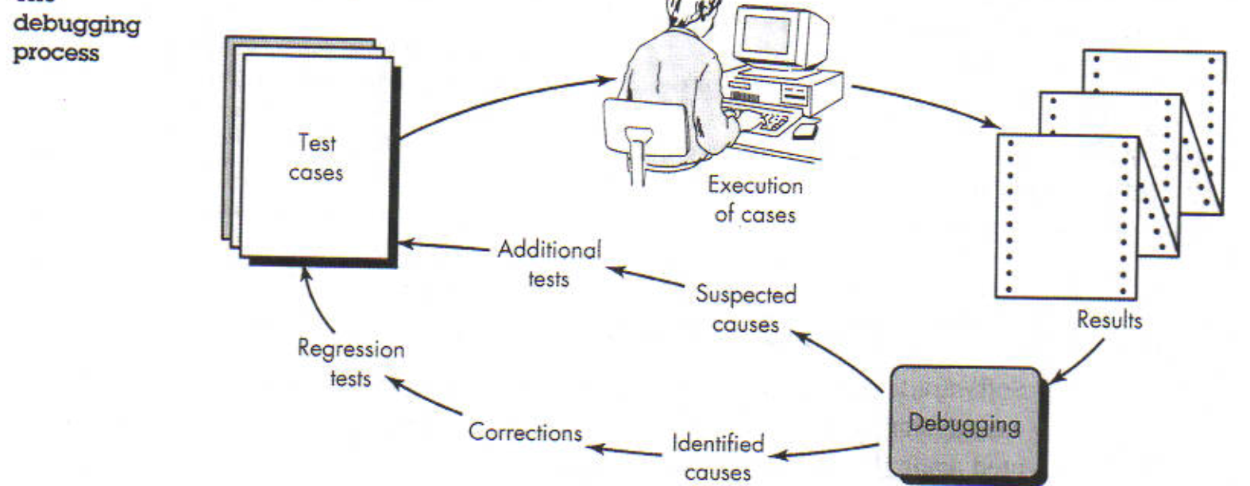

Slide 60
Debugging Strategies
Objective of debugging is to find and correct the cause of a software error
Bugs are found by a combination of systematic evaluation, intuition, and luck
Debugging methods and tools are not a substitute for careful evaluation based on a complete design model and clear source code
There are three main debugging strategies
  Brute force
  Backtracking
  Cause elimination

Slide 61
Strategy #1: Brute Force
Most commonly used and least efficient method
Used when all else fails
Involves the use of memory dumps, run-time traces, and output statements
Leads many times to wasted effort and time

Slide 62
Strategy #2: Backtracking
Can be used successfully in small programs
The method starts at the location where a symptom has been uncovered
The source code is then traced backward (manually) until the location of the cause is found
In large programs, the number of potential backward paths may become unmanageably large

Slide 63
Strategy #3: Cause Elimination
Involves the use of induction or deduction and introduces the concept of binary partitioning
  Induction (specific to general): Prove that a specific starting value is true; then prove the general case is true
  Deduction (general to specific): Show that a specific conclusion follows from a set of general premises
Data related to the error occurrence are organized to isolate potential causes
A cause hypothesis is devised, and the aforementioned data are used to prove or disprove the hypothesis
Alternatively, a list of all possible causes is developed, and tests are conducted to eliminate each cause
If initial tests indicate that a particular cause hypothesis shows promise, data are refined in an attempt to isolate the bug

Slide 64
Three Questions to ask Before Correcting the Error
Is the cause of the bug reproduced in another part of the program?
  Similar errors may be occurring in other parts of the program
What next bug might be introduced by the fix that I’m about to make?
  The source code (and even the design) should be studied to assess the coupling of logic and data structures related to the fix
What could we have done to prevent this bug in the first place?
  This is the first step toward software quality assurance
  By correcting the process as well as the product, the bug will be removed from the current program and may be eliminated from all future programs
☺

